Slide 1
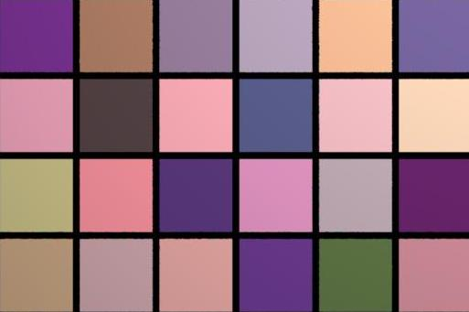

OSA 2011 Spectrum Estimation Competition

Slide 2
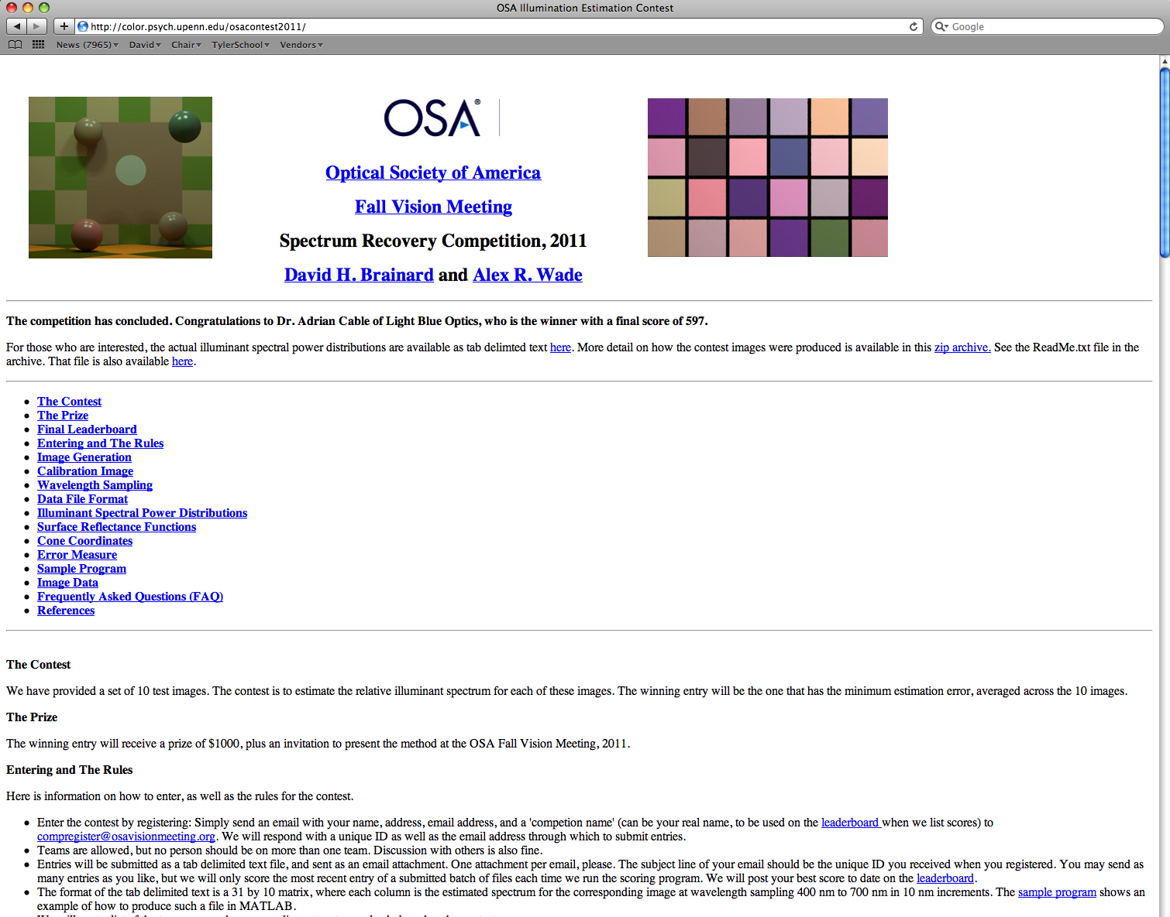
…

Slide 3
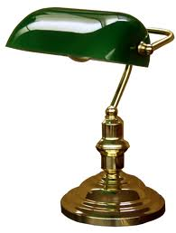
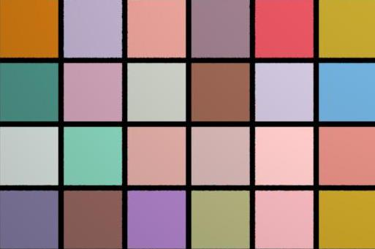
The problem…
?
?
=
*

Slide 4
The problem is underdetermined
Some constraints were provided as part of the contest: surfaces and illuminant spectra were within three dimensional linear models.
But additional assumptions are necessary to constrain the solution.
In essence, contest was to make assumptions that captured how the scenes were constructed.
Full details are now posted on the contest site, but were not available during the competition.
Some implicit clues: the surfaces used for images 1 and 2 were the same; some images contained visible spectral highlights and the specular reflectance component was spectrally flat.

Slide 5
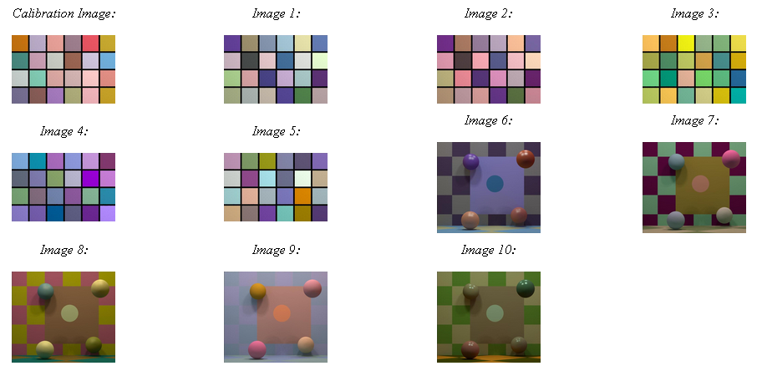
Ten synthetic contest images
Notes:
Two distinct types of images in the contest – tiled colour plates with minimal structure (images 1 – 5), and raytraced scenes (images 6 – 10) which may or may not contain shadowing, specular reflections etc.
The problem is hard because neither the surfaces nor the illuminants are known. What is known is that each image is rendered with a single light source. In the tiled images, color variations are due solely to surface reflectance changes. In the 3D rendered images, there can be shadows, interreflections etc…

Slide 6
Other contest features
Score determined by squared error difference between normalized submitted submitted and normalized illuminant spectra used to synthesize images, summed over images. Normalization meant that only relative spectrum mattered.
Any estimation method allowed, other than hacking into Brainard/Wade computers and finding the tabulated spectra there.
Scores posted once per week to limit use of brute force optimization.
A sample program that implemented a gray world algorithm was posted, and this also provided a baseline “score to beat”.
Prize: $1000 and invitation to give this talk. (Winner unable to attend.)
Notes:
After the first few entries, updating was limited to once a week to prevent subjects from using the scores themselves to iterate through the solution space. We assumed that there were at least 30 variables - too many for a brute force search.

Slide 7
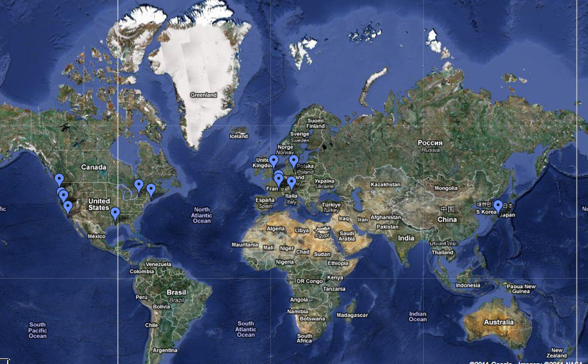
Entries were received from around the world
Notes:
A cluster of about 20 in MIT…. Others from France, Italy, Germany, UK, Japan, Canada. Several from the West Coast. Thanks to Bill Freeman for assigning entering the contest as a problem set in his graduate computer vision class.

Slide 8
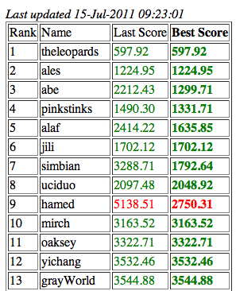
Final leaderboard
Notes:
A cluster of about 20 in MIT…. Others from France, Italy, Germany, UK, Japan, Canada. Several from the West Coast.

Slide 9
Scores over course of the contest
Slide courtesy Adrian Cable
Notes:
The leaderboard scores improved over time and competition was fierce towards the end. The true scores are lower than they might seem because at least two of the best competitors ‘camouflaged’ their error scores to disguise their progress (or, because it was not necessary to submit the best estimate for the entire set each time).

Slide 10
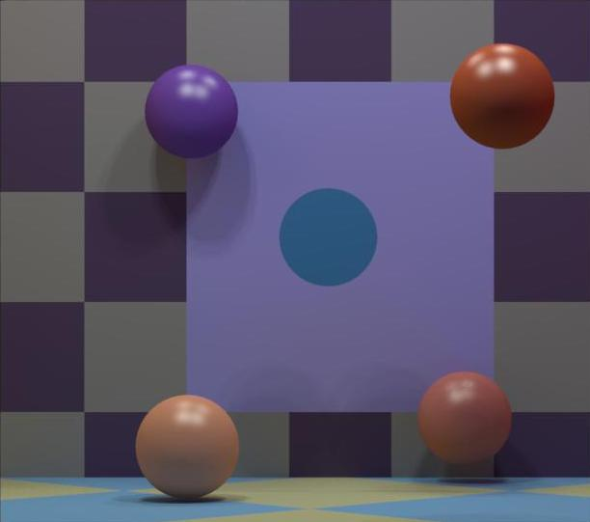
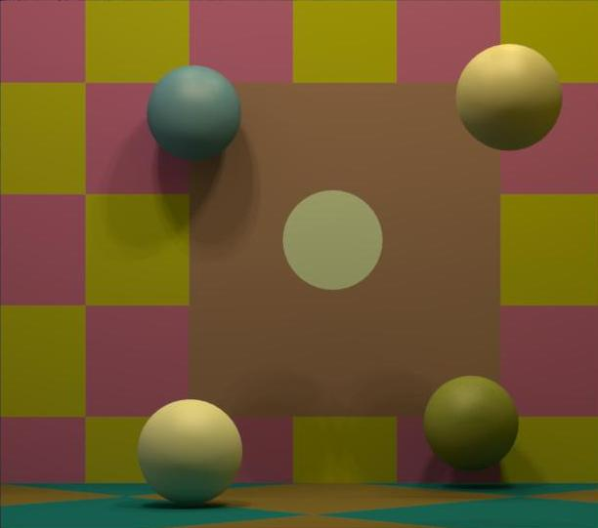
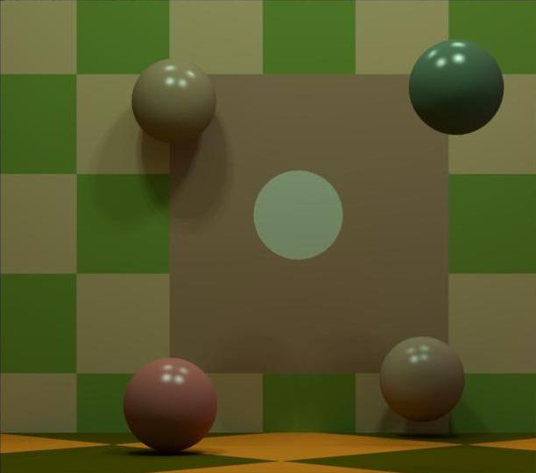
Approaches Used
Identify specular highlights in some images, and use these to estimate scene illuminant.
Notes:
Several competitors used these to directly estimate the illuminant. Ales used the highlighted ‘almost specular’ region in 8 and a nearby non-specular region and estimated the diffuse and specular components by assuming that the bright spot was composed of a specular+diffuse component while he nearby region was just diffuse. At least two entrants referenced Lee, JOSA A 1986.
Indeed, this assumption was valid for the the images with spheres, although the strength and spread of the specular component varied across images.

Slide 11
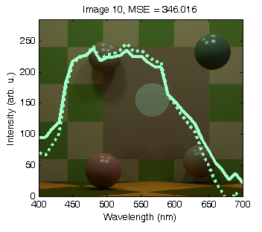
Specular highlight example
Slide courtesy Adrian Cable
Notes:
Example right shows image 10 actual illuminant spectrum (solid line), and spectrum estimated using above approach (dotted line) – MSE is 346 (i.e. this image would contribute 34.6 to the total leaderboard score – which is not very much error)

Slide 12
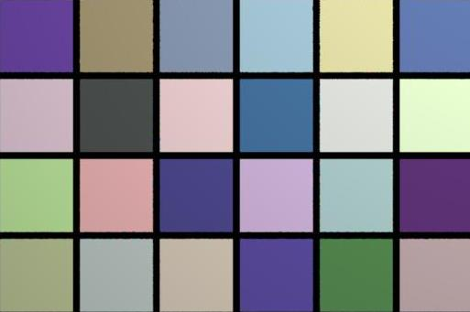
Approaches Used
Infer (correctly as it happens) from relation of between square cone responses that same surfaces were used to synthesize images 1 and 2. Use this with method of D’Zmura and Iverson to estimate illuminant in each scene.
Notes:
One group inferred that images 1 and 2 were of the same surfaces under different illuminants. This inference was correct.

Slide 13
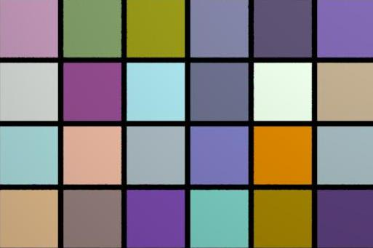
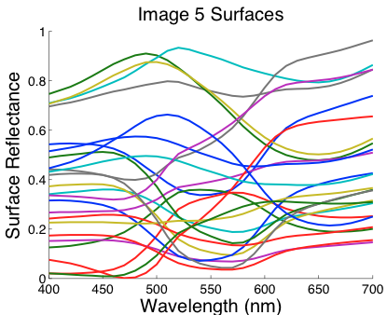
Approaches Used
Guess that some patch was spectrally flat. Not exactly true, but close for some surfaces. (Contestant didn’t tell us which one they thought was spectrally flat.)
Notes:
One group assumed that this patch was white and used that to estimate the illuminant.

Slide 14
Approaches
Assume a prior over surfaces and illuminants and employ Bayesian methods. Will work great if assumed priors match those used to construct images, but will suffer when assumed prior is incorrect. The two entries based on this approach achieved the second and fifth best scores.
Method used to achieve third best score not known to us (yet).
Use constraints that surface reflectance constrained between 0 and 1 and that illuminant spectra are positive. This led to the fourth best score.

Slide 15
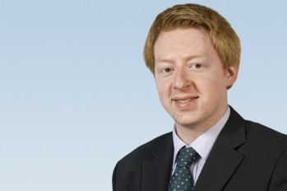

The winner
Dr Adrian Cable
“theleopards”
Dr. Cable unable to attend to give this presentation. Slides shown today based on slides he prepared.

Slide 16
The winning approach
The OSA contest is intractable without additional information about each image due to the underdetermination of the underlying spectrum recovery problem
There is one piece of information we have not yet considered so far – the leaderboard score itself, i.e. the MSE between actual illuminant spectra and competitor estimates
Use of the leaderboard score by contest competitors to hone submissions is permitted by the contest rules
The leaderboard scores for contest submissions convey enough information to recover the corresponding illumination spectra for each image exactly
In fact – surprising as this may seem – the leaderboard score is the only information needed to extract the illuminant spectrum for each image with zero error
  The contest images themselves are not needed (!)
Slide courtesy Adrian Cable
Notes:
In his own words….

Slide 17


Form of posted scores
Each submission consists of ten (31-element) illumination spectrum estimates, one per image
  Let x_{i} be the real spectrum vectors (unknown to the contestants), and y_{i} be the respective submitted estimates, for each image i
According to the contest rules, to evaluate the leadership score, the MSE e_{i} is first calculated for each image i as follows, where k_{i} is chosen to minimise e_{i} (needed to ensure that submissions are scored in a scale-invariant manner)
Solving the for the minimizing value of k_{i} gives
The leaderboard score is the mean of the e_{i} over all the images
Slide courtesy Adrian Cable

Slide 18


Principle of winning approach
Submit candidate spectra y_{i}, and from the leaderboard scores e_{i} deduce the x_{i} (sounds like a 31-dimensional problem!)
But… both the x_{i} and y_{i} can be expressed as a linear sum of basis vectors B (supplied as B_illum.mat), so the corresponding linear weights b_{i} and a_{i} respectively can be determined by using the Moore-Penrose pseudo-inverse of the matrix B with columns equal to the basis vectors
The Bb_{i}.Bb_{i} term in the above is not useful – it represents the magnitude of the illuminant x_{i} which is not needed.
The term on the right looks promising – can we use our submissions y_{i} = Ba_{i} and the corresponding leaderboard scores e_{i} to determine the a_{i} and hence recover the image illuminant spectra x_{i} (sounds like a 3-dimensional problem)?
Slide courtesy Adrian Cable

Slide 19

Difference probes
Call the submission to the contest of a single complete spectrum set (y = Ba,) a probe. Each submission has 3 x 10 independent variables
y is a 31 x 10 matrix of submitted image spectra, B is the 31 x 3 basis vector matrix, a is the 3 x 10 basis vector representation of y – the probe vector
Consider pairs of probes, a and a*, which differ only in one image (i.e. column) k, and call the corresponding column of the complete probes a_{k} and a_{k}*, with corresponding spectra Ba_{k} and Ba_{k}* respectively
Each probe, when submitted to the contest, will return an MSE which we will term e and e* respectively
The difference Δe = e – e* is then given by
Writing column k of the probe vector a_{k} = (a₁ a₂ a₃) and the real unknown spectrum of image k as b_{k} = (b₁ b₂ b₃) we see that the above represents a scalar nonlinear equation with three unknowns, simply b₁, b₂ and b₃
?
?
Slide courtesy Adrian Cable
Notes:
When talking about the equation – highlight the fact that we want to know b which is a 3x1 vector for any single image. And we know all of the other things: (a, B)

Slide 20
Difference probes (continued)
Submitting three probe pairs, (a, a*), (a’, a’*), (a’’, a’’*), enables us to compute b_{k} and hence the illuminant spectrum for image k given by x_{k} = Bb_{k}
The actual probes themselves (the columns of a_{k} corresponding to the kth image) are completely arbitrary – any linearly independent vectors can be used.
It seems as though six submissions are needed to recover the illuminant spectrum for each image. But if we set a = a’ = a’’, the probe pairs are still linearly independent as required, reducing the number of submissions per image to four
We can do even better than that, because we already have a set of spectrum vectors computed by the grayWorld algorithm included in the competition pack, and importantly the score for these – 3544.88 – giving us an additional probe.
In the “live method” we set a to be the corresponding spectral vector estimates from grayWorld, with the kth column of the a*, a’* and a’’* being equal to the kth column of a plus an orthogonal unit vector in rows 1, 2 and 3 respectively – this ensures that the kth columns of a*, a’* and a’’* are linearly-independent
Leaderboard scores from 3 submissions per image can reconstruct the spectrum
Slide courtesy Adrian Cable

Slide 21
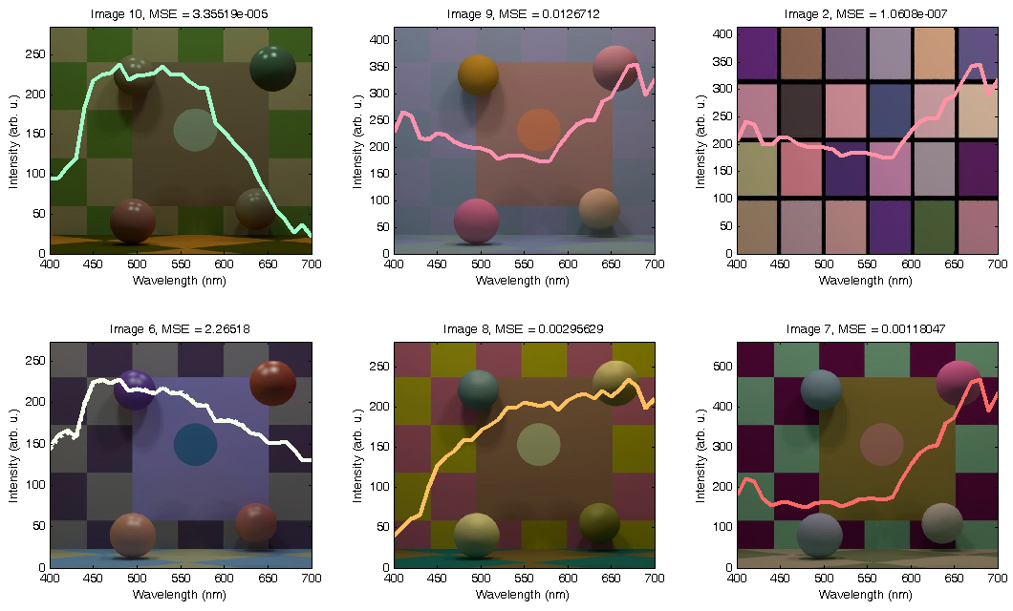
Recovered spectra from six images
Slide courtesy Adrian Cable
Notes:
Note – At first it seems odd that he should have picked two or three scenes where he could have estimated the reflectance directly from specular highlights. However 1) When we started we began with a faster scoring schedules and he assumed he would have time to finish all the scenes 2) He wanted to make a point (that you didn’t need the images to estimate the illum) and 3) “The second reason relates to a weakness with the method I used. Basically, correct me if I am wrong, but I believe that in the scene set-up, the light sources were much closer to the objects in the raytraced scenes than in the tiled-plate scenes. (You probably did this to ensure the illumination of the plate scenes was roughly spatially flat in intensity over the tiles.) One consequence of this is that the returned MSE deltas are much smaller for the tiled plate scenes than for the raytraced scenes. The probe method suffers from a limitation that if the probe happens to be close to the null space of the equation set built up from the returned MSE scores, then small errors in the returned MSE scores can lead to very large errors in the reconstructed spectrum. Because the MSE values were only returned to two decimal places this can have a significant effect if two probes lead to only a small MSE difference, which happened with the tiled plate scene I probed. I put together a model which graphed worst-case spectrum recovery errors given the two decimal place MSE rounding and it can be quite large! So this provided another good reason to “stay away” from the tiled-plate scenes because the next one could have been even worse.”

Slide 22
No time to recover all the spectra
Leaderboard updates were done only once per week – no time to recover spectra for the whole image set using this method
18 probes were done (recovering the spectra of 6 images – enough to win the contest), plus the final submission which gave an MSE of 597.92, for a total of 19 contest submissions
Slide courtesy Adrian Cable

Slide 23
“I feel cheated”
One might argue that the method described here is “cheating” because, while it leads to a good (winning) solution, it arguably does not contribute anything to the very interesting problem of illuminant spectrum recovery, instead exploiting an information leak in the leaderboard score (an artificial element added to turn the problem into a competition)
However, I would strongly disagree, for several reasons
  The published rules of the contest were adhered to rigidly
  The method described here of probing to extract unknown parameters inside a black box does have applications in solving a wide range of real world problems
  The competition problem (spectrum recovery) is really intractable in the general case without some higher-level knowledge, as described earlier – the MSE score is just one source for such knowledge, which dispassionately is really no better or worse than any other source of knowledge which is not really related to the image (e.g. being told the dimensionality of the surface spectra basis space is lower than the illuminant space dimensionality, etc.)
  Scientific discoveries often result from finding information in unexpected places – clearly no “scientific discovery” has occurred here but the mindset used to think about how to solve the competition problem is very much applicable to genuine, hard problems
Nonetheless, there are ways to prevent this sort of method from being used in future versions of this sort of challenge.
Slide courtesy Adrian Cable

Slide 24
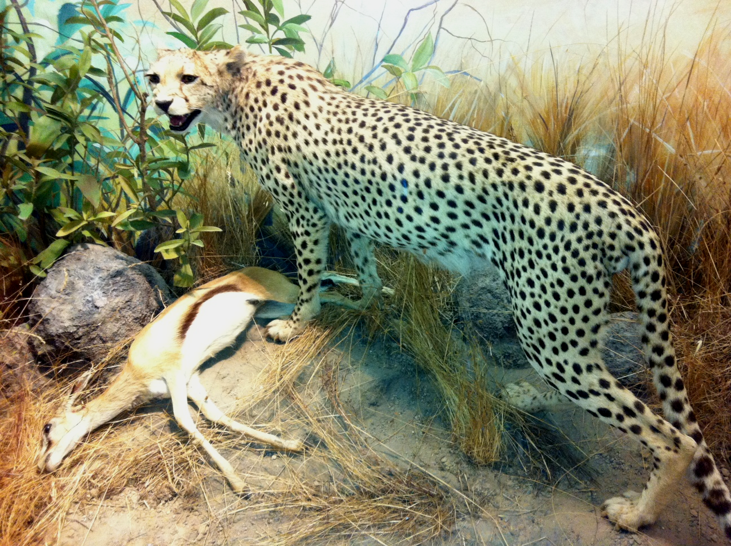
Thank you from “theleopards” – not really “cheatahs” after all
Slide courtesy Adrian Cable

